Slide 1
Information Management System Lab
ECSE211L
Bennett University

Slide 2
List of queries
CREATE DATABASE - creates a new database
CREATE DATABASE databasename;
CREATE TABLE - creates a new table
CREATE TABLE table_name ( column1 datatype,....);
ALTER TABLE - modifies a table
ALTER TABLE table_name ADD column_name datatype;
DROP TABLE - deletes a table
DROP TABLE table_name;
SQL Constraints
- CREATE TABLE table_name ( column1 datatype constraint,....);(not null, unique,check,primary key)
SELECT - extracts data from a database
SELECT * FROM Table name;
SELECT DISTINCT column1, column2, ...FROM table_name;
UPDATE - updates data in a database
UPDATE table_name SET column1 = value1, column2 = value2, ... WHERE condition;
DELETE - deletes data from a database
DELETE FROM table_name WHERE condition; (AND, OR and NOT Operators)
INSERT INTO - inserts new data into a database
INSERT INTO table_name (column1, column2, column3, ...) VALUES (value1, value2, value3, ...);
ORDER BY,limit,
select *from orders ORDER BY amount LIMIT 5 OFFSET 3;

Slide 3

Orders table
create table orders(
oid int(10),
orderdate date,
amount varchar(20),
cid int(10));
INSERT INTO orders (oid, orderdate,amount,cid) values ('1','2020-04-04','100','1');
INSERT INTO orders (oid, orderdate,amount,cid) values ('2','2020-05-05','200','2');
INSERT INTO orders (oid, orderdate,amount,cid) values ('3','2020-06-06','300','1');
INSERT INTO orders (oid, orderdate,amount,cid) values ('4','2020-07-07','400','3');
INSERT INTO orders (oid, orderdate,amount,cid) values ('5','2020-08-08','500','4');
select * from orders;

Slide 4

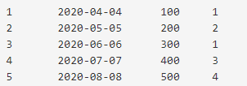
Between Clause
select * from orders where amount >=200 and amount <=500;
oid orderdate amount cid
select * from orders where amount BETWEEN 200 and 500;

Slide 5
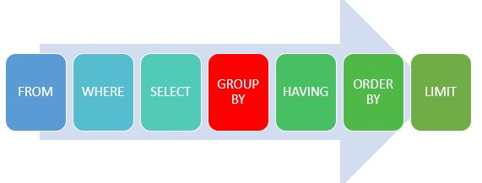
Group By Clause
It groups a set of rows by values of columns or expressions.
It returns one row for each group.
It is used with aggregate functions such as SUM, AVG, MAX, MIN and COUNT.

Slide 6
Group By Clause Contd…
Syntax:
Select c1, c2 …..
From Tablename
where condition
Group By c1, c2, …, cn;
Example:
SELECT cid, count(*)
FROM orders
GROUP BY cid;

Slide 7


HAVING Clause
It is added to SQL because the WHERE keyword could not be used with aggregate functions.
Syntax:
SELECT column_name(s)
FROM table_name
WHERE condition
GROUP BY column_name(s)
HAVING condition
ORDER BY column_name(s);
Example
SELECT COUNT(CustomerID), Country
FROM Customers
GROUP BY Country
HAVING COUNT(CustomerID) > 5
ORDER BY COUNT(CustomerID) DESC;

Slide 8



Count, Group By, IN, MAX, MIN Clause
SELECT COUNT(*) FROM orders;
SELECT cid, COUNT(*) FROM orders GROUP BY cid;
SELECT oid, amount, cid FROM orders where amount IN(100,300,500);
SELECT MAX(amount) FROM orders;
SELECT MIN(amount) FROM orders;
Note: In operator allows you to specify multiple values in a where clause
oid orderdate amount cid
cid count
oid amount cid

Slide 9


SUM, AVG, RAND, SQRT Clause
oid orderdate amount cid
SELECT SUM(amount) FROM orders;
SELECT AVG(amount) FROM orders;
SELECT RAND( ), RAND( ), RAND( );
select SQRT(16);
Note: NULL values are ignored.

Slide 10
SQL Aliases
SQL aliases are used to give a table, or a column in a table, a temporary name.
Aliases are often used to make column names more readable.
An alias only exists for the duration of the query.
Syntax
SELECT column_name AS alias_name
FROM table_name;
Example:
SELECT CONCAT(City, " ", Country) AS Address FROM Customers;
Advantages:
There are more than one table involved in a query
Functions are used in the query
Column names are big or not very readable
Two or more columns are combined together
Note: It requires double quotation marks or square brackets if the alias name contains spaces:

Slide 11
LIKE clause
The LIKE operator is used in a WHERE clause to search for a specified pattern in a column.
There are two wildcards used in conjunction with the LIKE operator:
% - The percent sign represents zero, one, or multiple characters
_ - The underscore represents a single character
LIKE Syntax •
SELECT column1, column2, ...
FROM table_name
WHERE columnN LIKE pattern;

Slide 12
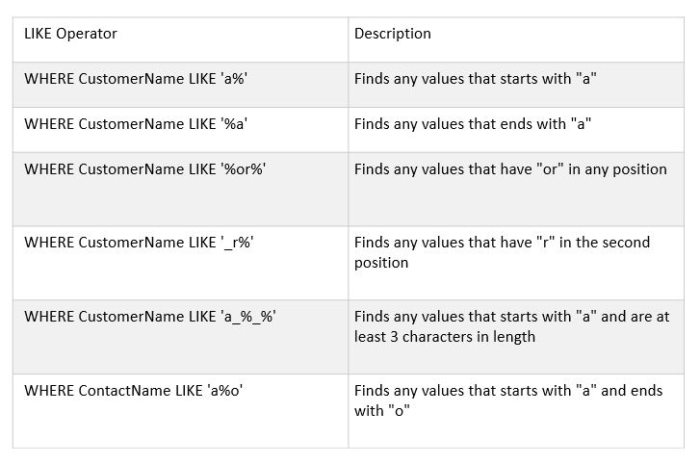

Slide 13
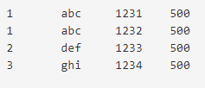

LIKE clause contd…
create table orders(
cid int(10),
cust_name varchar (10),
oid int(10),
amount int(20));
INSERT INTO orders (cid, cust_name, oid, amount) values (1, 'abc', 1231, 500);
INSERT INTO orders (cid, cust_name, oid, amount) values (1, 'abc', 1232, 500);
INSERT INTO orders (cid, cust_name, oid, amount) values (2, 'def', 1233, 500);
INSERT INTO orders (cid, cust_name, oid, amount) values (3, 'ghi', 1234, 500);
select * from orders;
select * from orders where cust_name LIKE ‘b%';

Slide 14


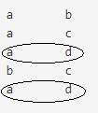

UNION
create table A(
one varchar(5),
two varchar(5));
create table B(
three varchar(5),
four varchar(5));
INSERT INTO A (one, two) values ('a','b');
INSERT INTO A (one, two) values ('a','c');
INSERT INTO A (one, two) values ('a','d');
INSERT INTO B (three, four) values ('b','c');
INSERT INTO B (three, four) values ('a','d');
SELECT * from A; SELECT * from B;
SELECT one, two FROM A UNION ALL SELECT three, four FROM B;
SELECT one, two FROM A UNION SELECT three, four FROM B;
Duplicate
Rows
No Duplicate
Rows

Slide 15
Orders table
create table orders(
oid int(10),
orderdate date,
amount varchar(20),
cid int(10));
INSERT INTO orders (oid, orderdate,amount,cid) values ('1','2020-04-04','100','1');
INSERT INTO orders (oid, orderdate,amount,cid) values ('2','2020-05-05','200','2');
INSERT INTO orders (oid, orderdate,amount,cid) values ('3','2020-06-06','300','1');
INSERT INTO orders (oid, orderdate,amount,cid) values ('4','2020-07-07','400','3');
INSERT INTO orders (oid, orderdate,amount,cid) values ('5','2020-08-08','500','4');
select * from orders;

Slide 16

Customers Table
Create table customers(
cid int(10),
cname varchar(30),
cemail varchar(20));
INSERT INTO customers (cid,cname,cemail) values ('1','A','A@mail.com');
INSERT INTO customers (cid,cname,cemail) values ('2','B','B@mail.com');
INSERT INTO customers (cid,cname,cemail) values ('3','C','C@mail.com');
INSERT INTO customers (cid,cname,cemail) values ('5','D','D@mail.com');
select * from customers;

Slide 17

Two Tables
cid cname cemail oid orderdate amount cid
select * from customers, orders where customers.cid=orders.cid ;

Slide 18
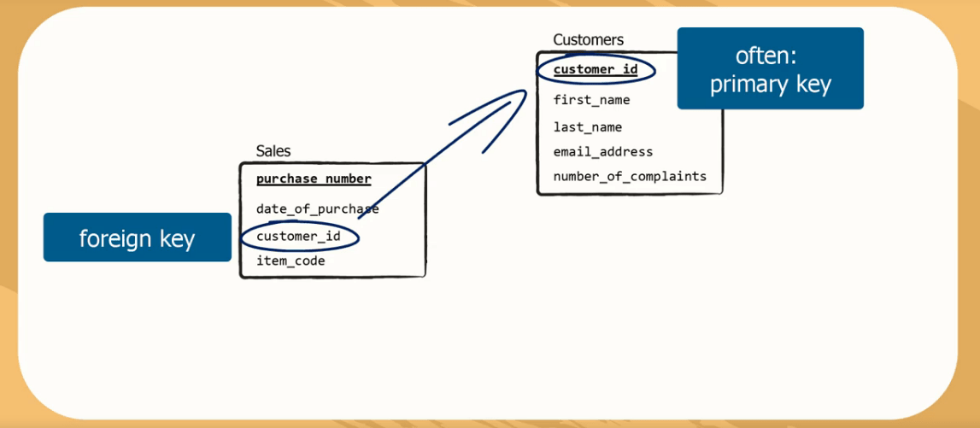
Foreign Key

Slide 19
SQL FOREIGN KEY Constraint
CREATE TABLE Persons (
Person_id int AUTO_INCREMENT,
name VARCHAR(30) NOT NULL,
age int NOT NULL,
PRIMARY KEY (Person_id)
);
CREATE TABLE Orders (
OrderID int NOT NULL,
OrderNumber int NOT NULL,
PersonID int,
PRIMARY KEY (OrderID),
CONSTRAINT FK_PersonOrder FOREIGN KEY (PersonID)
REFERENCES Persons(PersonID)
);
Add Foreign Key:
ALTER TABLE Orders ADD CONSTRAINT FK_PersonOrder FOREIGN KEY (PersonID) REFERENCES Persons(Person_id);
Drop Foreign Key:
ALTER TABLE Orders DROP FOREIGN KEY FK_PersonOrder;

Slide 20


SQL FOREIGN KEY Constraint
insert into student (name, age) values ('abc',25);
insert into student (name, age) values ('cde',20);
select *from student;
insert into enrol (stud_id) values (1);
insert into enrol (stud_id) values (2);
select *from enrol;
CREATE TABLE student (
stud_id int AUTO_INCREMENT,
name VARCHAR(30) NOT NULL,
age int NOT NULL,
PRIMARY KEY (stud_id)
);
CREATE TABLE enrol(
roll_no int NOT NULL AUTO_INCREMENT,
student_id int NOT NULL,
PRIMARY KEY(roll_no),
FOREIGN KEY (student_id) REFERENCES student (stud_id)
);

